Slide 1
JSP Servlet JDBC MySQL Create Read Update Delete (CRUD)
Credits: https://www.javaguides.net/2019/03/jsp-servlet-jdbc-mysql-crud-example-tutorial.html

Slide 2
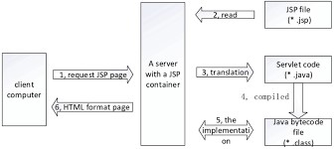
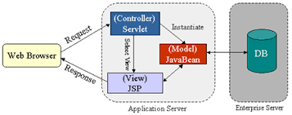
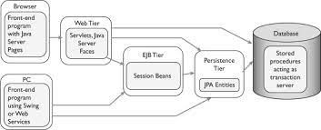
https://docs.oracle.com/cd/E14571_01/web.1111/e13712/basics.htm#WBAPP643 What JAR file contains? Jar files can contain any kind of files, but they usually contain class files and supporting configuration files (properties), graphics and other data files needed by the application. Using JDBC in Java servlet enables you to develop servlets that can perform database connectivity.

Slide 3
Technologies We Will Use:
Java Servlets and Java Server Pages (JSP)
JSP Standard Tag Library (JSTL)
Java Database Connectivity (JDBC)
MySQL database
Apache Tomcat Server

Slide 4
Steps:
Create an Eclipse Dynamic Web Project
Add Dependencies
Project Structure
MySQL Database Setup
Create a JavaBean - User.java
Create a UserDAO.java
Create a UserServlet.java
Creating User Listing JSP Page - user-list.jsp
Create a User Form JSP Page - user-form.jsp
Creating Error JSP page
Deploying and Testing the Application Demo

Slide 5
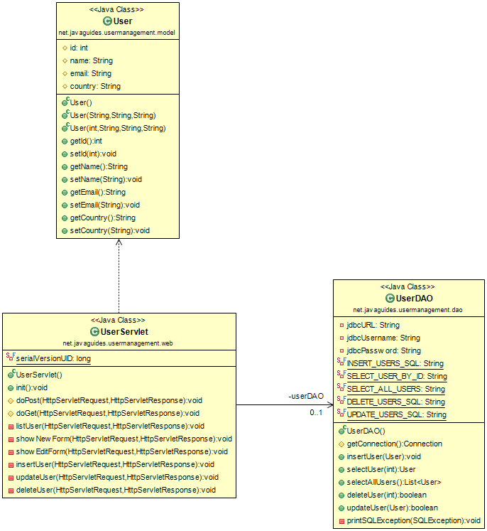

Slide 6
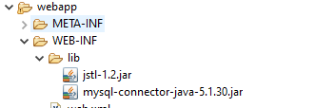
Dependencies:
You’ll have to add the following to your lib folder:

Slide 7
DAO – DATA ACCESS OBJECT
Code that depends on specific features of data resources ties together business logic with data access logic. This makes it difficult to replace or modify an application's data resources.
The Data Access Object (or DAO) pattern:
separates a data resource's client interface from its data access mechanisms
adapts a specific data resource's access API to a generic client interface
The DAO pattern allows data access mechanisms to change independently of the code that uses the data.

Slide 8
Creating MySQL Database
CREATE DATABASE ‘userdemo';
USE userdemo;
create table users (
id int(3) NOT NULL AUTO_INCREMENT,
name varchar(120) NOT NULL,
email varchar(220) NOT NULL,
country varchar(120),
PRIMARY KEY (id)
);

Slide 9
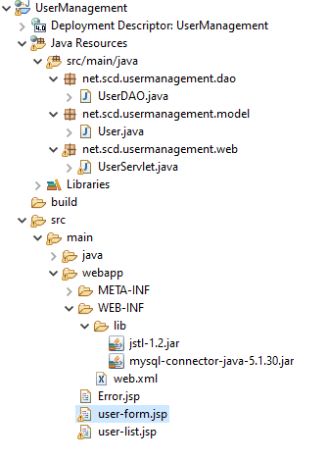
Project Structure

Slide 10
Creating Error JSP page
<%@ page language="java" contentType="text/html; charset=UTF-8"
pageEncoding="UTF-8" isErrorPage="true" %>
<!DOCTYPE html PUBLIC "-//W3C//DTD HTML 4.01 Transitional//EN"
"http://www.w3.org/TR/html4/loose.dtd">
<html>
<head>
<title>Error</title>
</head>
<body>
<center>
<h1>Error</h1>
<h2><%=exception.getMessage() %><br/> </h2>
</center>
</body>
</html>

Slide 11
Adding Error Page to web.xml
<?xml version="1.0" encoding="UTF-8"?>
<web-app xmlns:xsi="http://www.w3.org/2001/XMLSchema-instance" xmlns="http://xmlns.jcp.org/xml/ns/javaee" xsi:schemaLocation="http://xmlns.jcp.org/xml/ns/javaee http://xmlns.jcp.org/xml/ns/javaee/web-app_4_0.xsd" id="WebApp_ID" version="4.0">
<display-name>UserManagement</display-name>
<welcome-file-list>
<welcome-file>index.html</welcome-file>
<welcome-file>index.jsp</welcome-file>
<welcome-file>index.htm</welcome-file>
<welcome-file>default.html</welcome-file>
<welcome-file>default.jsp</welcome-file>
<welcome-file>default.htm</welcome-file>
</welcome-file-list>
<error-page>
<exception-type>java.lang.Exception</exception-type>
<location>/Error.jsp</location>
</error-page>
</web-app>

Slide 12
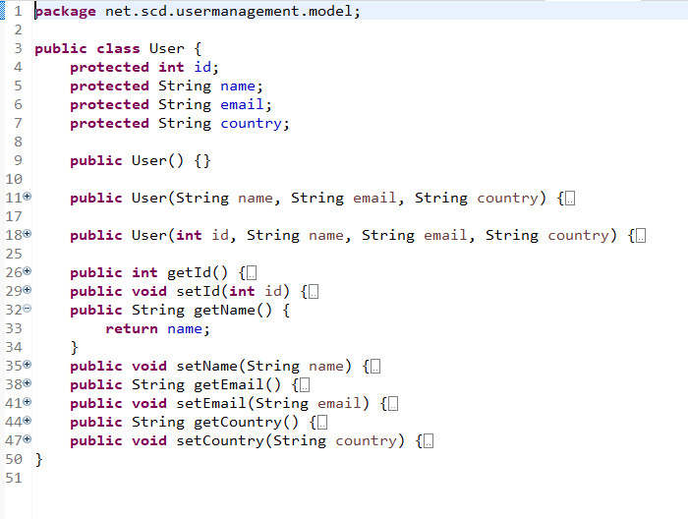
User.Java (model class)

Slide 13
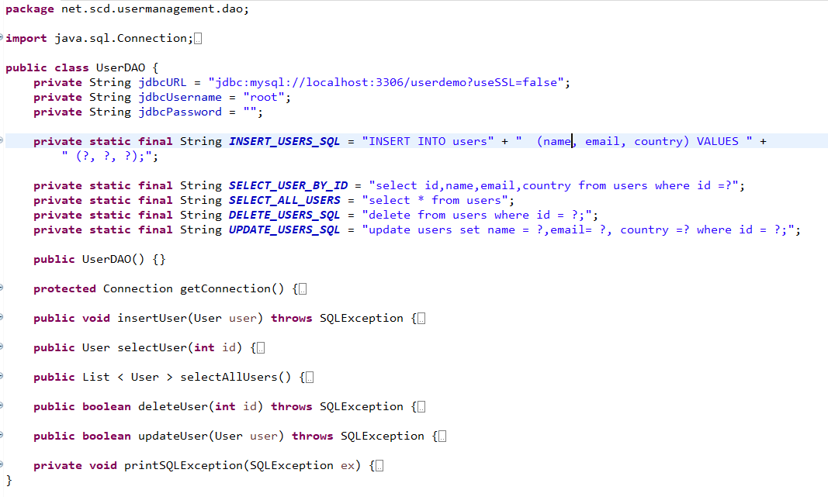
UserDAO.java (DAO class)

Slide 14
Insert function
public void insertUser(User user) throws SQLException {
System.out.println(INSERT_USERS_SQL);
// try-with-resource statement will auto close the connection.
try (Connection connection = getConnection(); PreparedStatement preparedStatement = connection.prepareStatement(INSERT_USERS_SQL)) {
preparedStatement.setString(1, user.getName());
preparedStatement.setString(2, user.getEmail());
preparedStatement.setString(3, user.getCountry());
System.out.println(preparedStatement);
preparedStatement.executeUpdate();
} catch (SQLException e) {
printSQLException(e);
}
}

Slide 15
Get User List
public List < User > selectAllUsers() {
List < User > users = new ArrayList < > ();
try (Connection connection = getConnection();
PreparedStatement preparedStatement = connection.prepareStatement(SELECT_ALL_USERS);) {
System.out.println(preparedStatement);
ResultSet rs = preparedStatement.executeQuery();
while (rs.next()) {
int id = rs.getInt("id");
String name = rs.getString("name");
String email = rs.getString("email");
String country = rs.getString("country");
users.add(new User(id, name, email, country));
}
} catch (SQLException e) {
printSQLException(e);
}
return users;
}

Slide 16
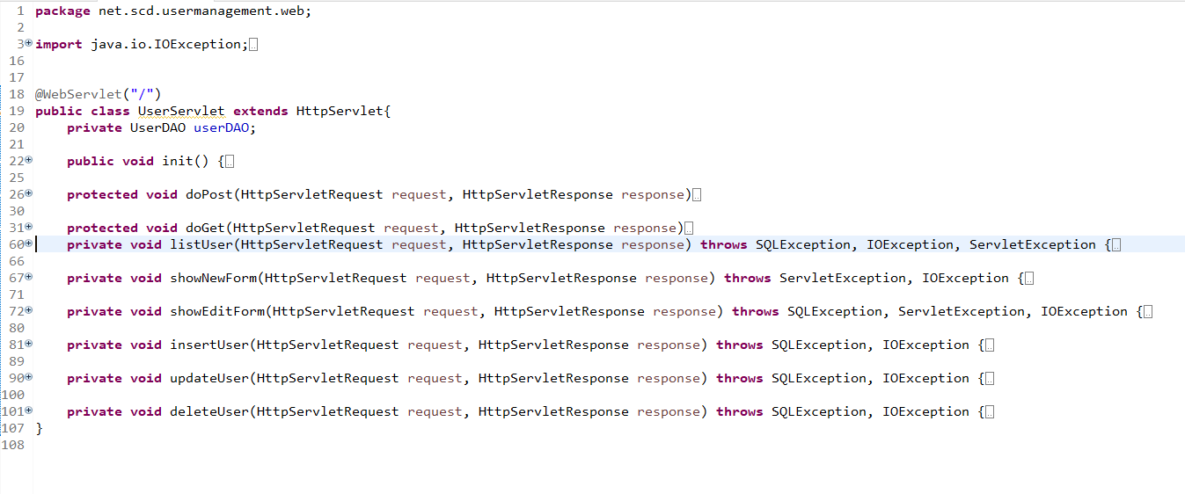
UserServlet.java (control class)

